Slide 1


Browsing for Metabolizing Enzymes and Transporter (MET) data
Retrieving high quality extracted MET data to anticipate safety risk
Marnix Wieffer, Senior marketing manager drug safety
m.wieffer@elsevier.com
https://www.linkedin.com/in/marnix-wieffer/
Notes:
Hello everybody and welcome to this tutorial video where we will show you how you can retrieving high quality extracted metabolizing and transported data by browsing for drugs in PharmaPendium

Slide 2
Learning objective
MET parameters available in PharmaPendium
How to browse for MET data based on an indication
Explore MET data results view
Filtering and sorting MET data
Zooming into source documents
At the end of this video you should have a good understanding of how to retrieve MET data using the browse feature
Notes:
At the end of this video you should have a good understanding of how to retrieve MET data using the browse feature. This will help to investigate for example Drug-drug interaction risk, optimize experimental design

Slide 3
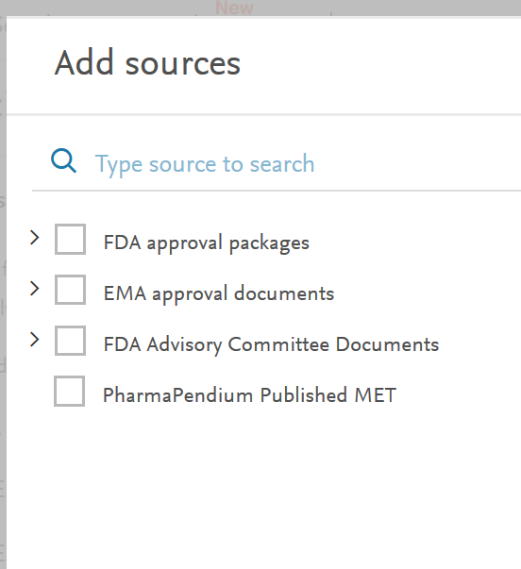
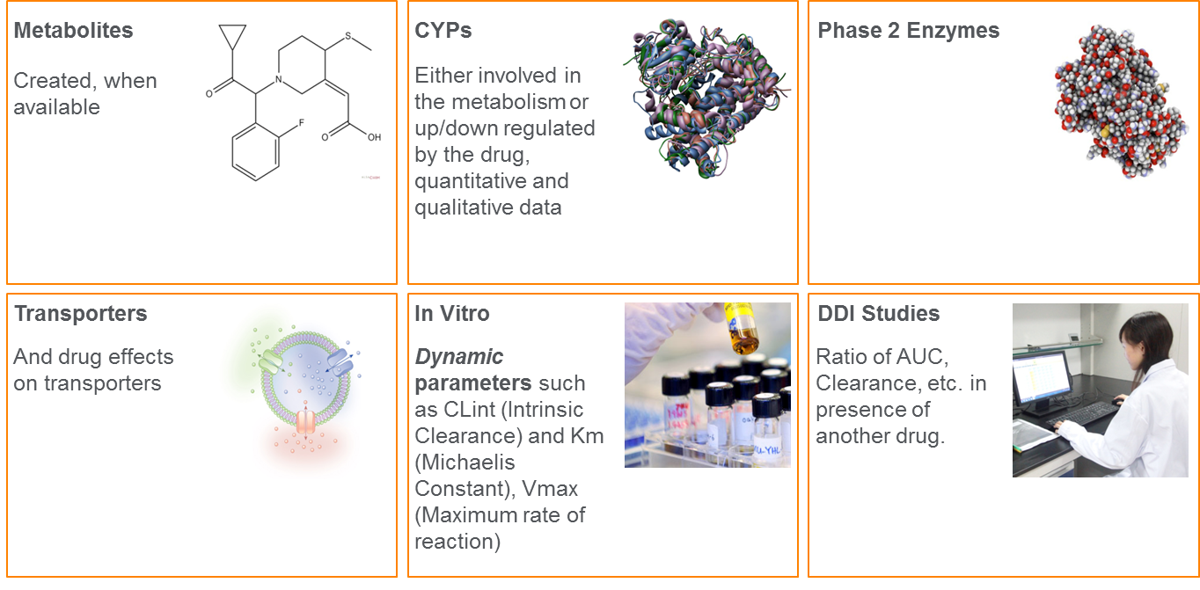
Metabolizing enzymes source information
Data sources
Data types
All with drugs as: Substrate, inducer or inhibitor
Notes:
Before diving into the live training, let take a brief look at where data is exacted from and what type of data is extracted. For the PharmaPendium MET module, we manually extract data from FDA……. From these sources we extract many different datatype including…….. These data will help us to answer critical questions around drug metabolism and drug-drug interaction risk. For example:

Slide 4
Example question
I am developing a new drug that I expect to be often co-administered with drugs for the treatment of “Atrial Flutter”
What metabolizing enzymes are inhibited by drugs acting on Atrial Flutter?
Impact: Optimize experimental design, reduce development risk and improve patient safety
Notes:
…… thereby potentially causing drug-drug interactions with my drug of interest. Quickly retrieving the relevant data will help me to identify what enzymes to particularly focus on in my preclinical studies, thereby

Slide 5

Recommended to login
By login in to PharmaPendium you will have access to features that will help you to get the best out of PharmaPendium.
These include:
1. Saving searches
2. Sharing searches
3. Setting up email alerts

Slide 6
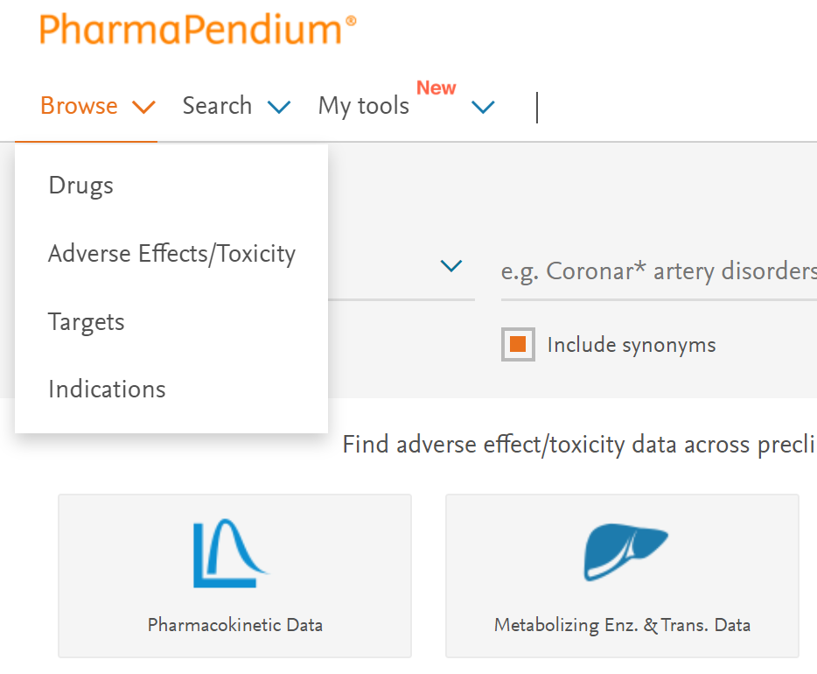
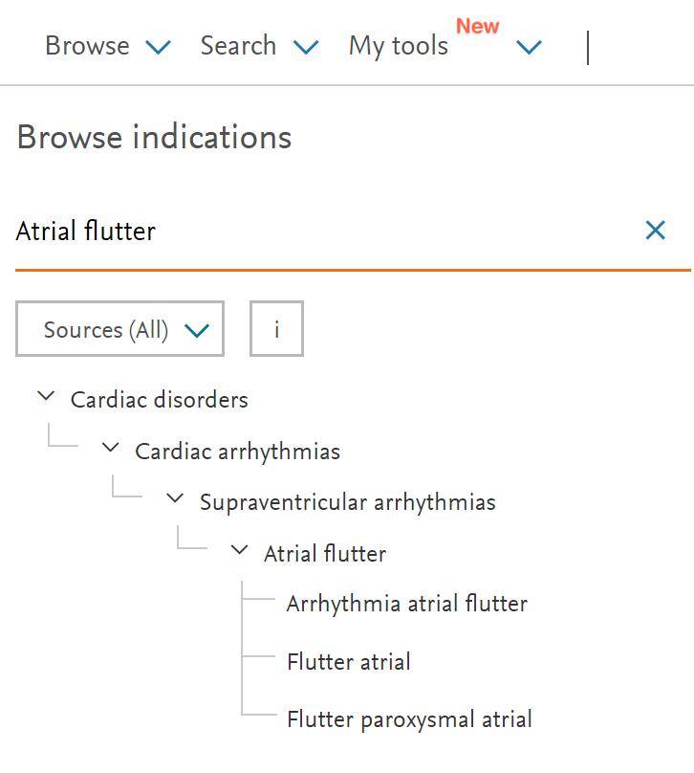
Browse for drug acting on indication of interest
Browse indication taxonomy or type term of interest

Slide 7
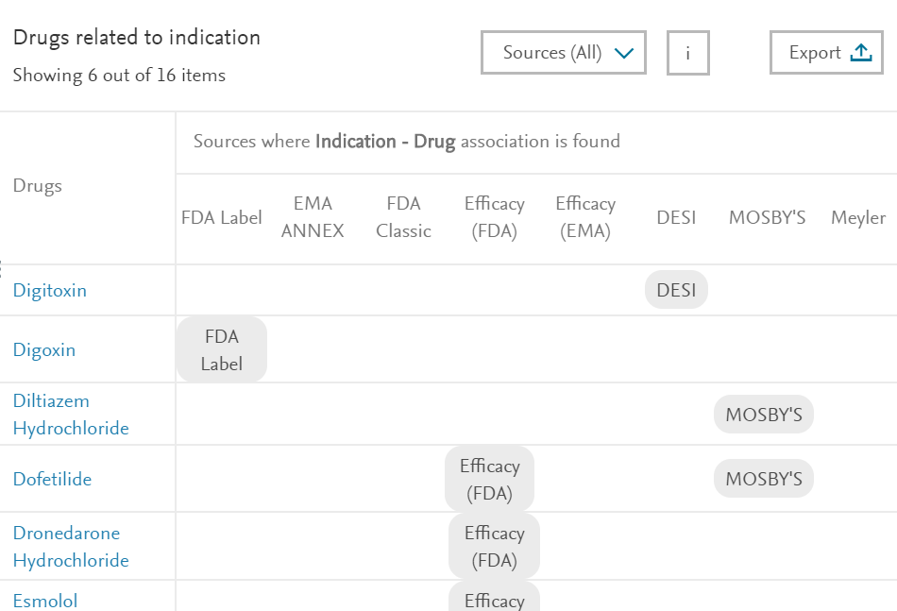
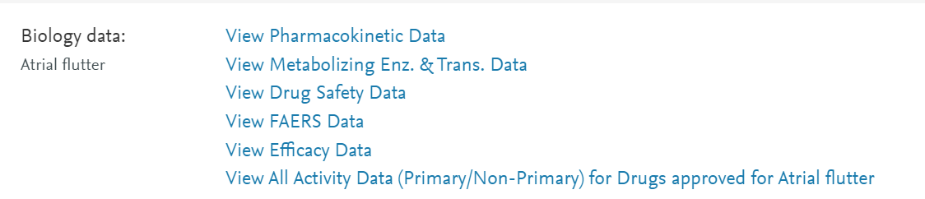
Browse for drug acting on indication of interest
16 approved drugs acting on Atrial Flutter
Take a look at extracted metabolizing enzymes & transporter data
Source of association
Notes:
In this video, DDI product manger Sherry Winter, will discuss

Slide 8
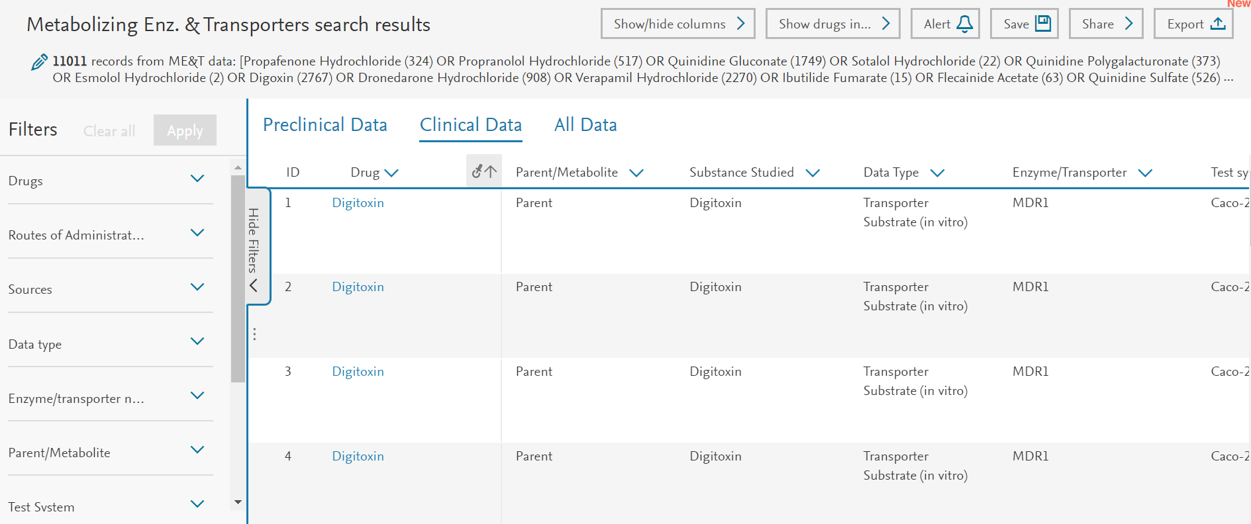
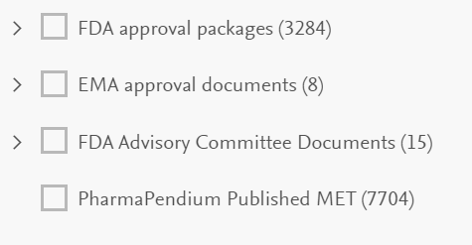
11011 extracted MET data lines
Data extracted from:
Notes:
In this video, DDI product manger Sherry Winter, will discuss

Slide 9
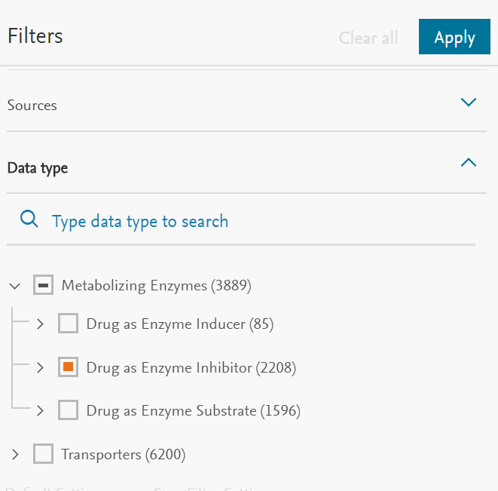
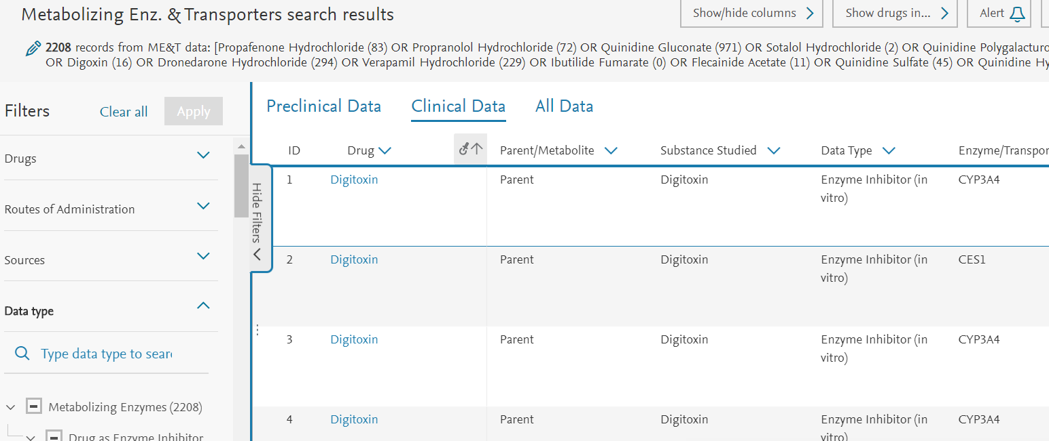
Filter on relevant data
2054 datapoints on drug acting on Atrial Flutter, as Enzyme inhibitor
Filter on “Drug as enzyme inhibitor” and press apply
Notes:
In this video, DDI product manger Sherry Winter, will discuss

Slide 10
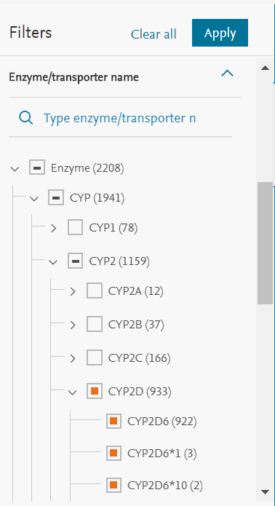
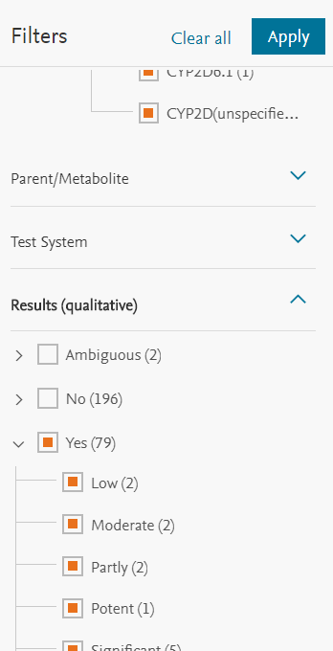
Most (933) data points on CYP2D6
Extracted qualitative assessment
Filter on “Drug as enzyme inhibitor”
Isoforms
Notes:
In this video, DDI product manger Sherry Winter, will discuss

Slide 11
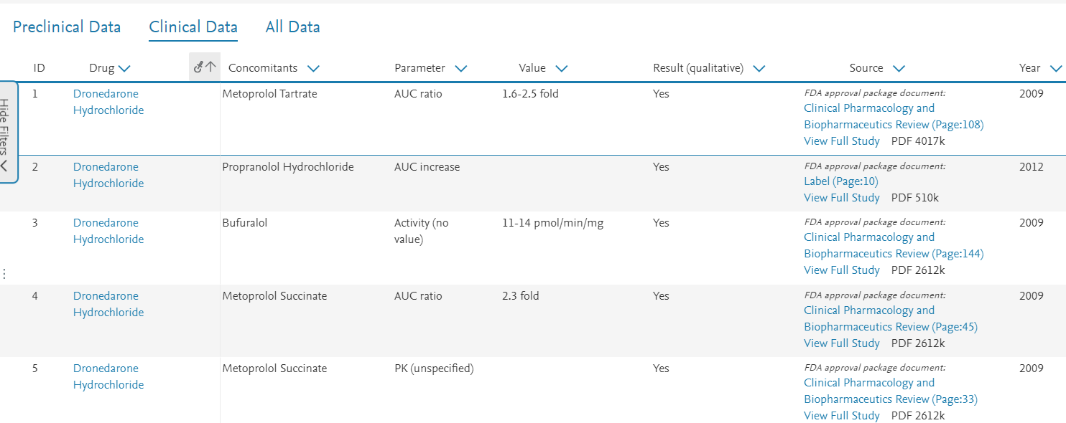
Dive into the source document
Suggested drug interaction with Metoprolol as concomitant
Investigate source document
Notes:
In this video, DDI product manger Sherry Winter, will discuss

Slide 12
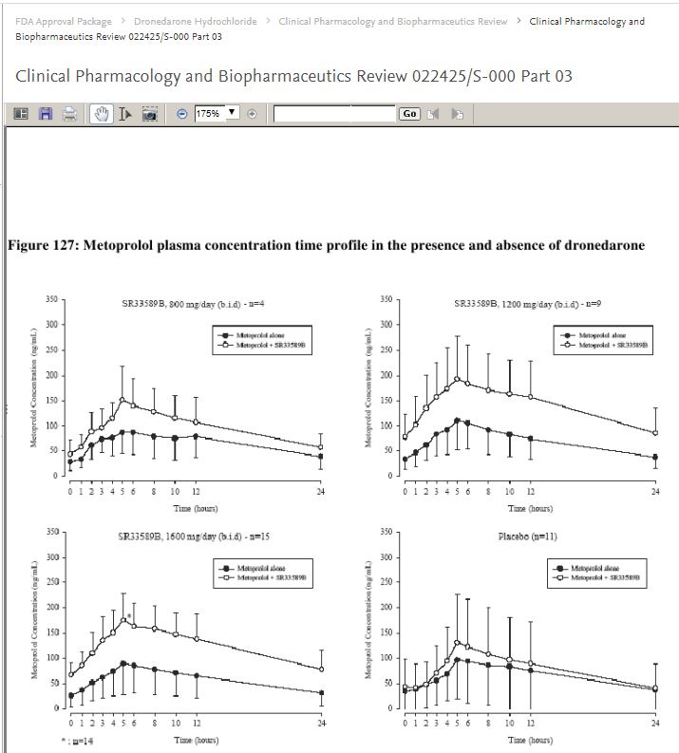
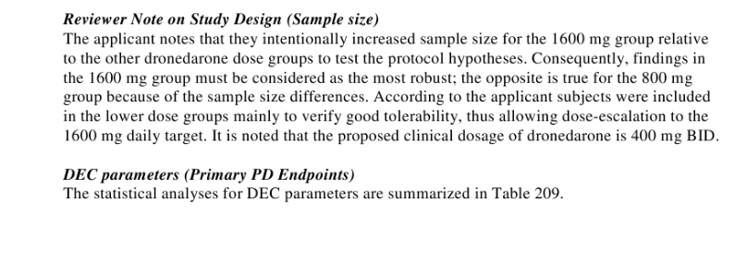
Direct access to source data
Notes:
In this video, DDI product manger Sherry Winter, will discuss

Slide 13
Notes:
With that I would like to thank you for your attention. I case of quetsions, please do not hesitate to get in touch.

